Slide 1

Wedding Management System

Slide 2

Our Team
Sunehra Tabassum
ID: 2254901047
Ameer Sohail Aurnab
ID: 2254901011

Slide 3
Preview
Introduction
Features
Conclusion

Slide 4
Introduction
The Wedding Management System is a web-based application that offers a seamless and intuitive platform for managing various aspects of wedding planning. It provides a robust set of features aimed at enhancing the user experience for both guests and administrators. Guests can easily sign up for an account, book wedding services, and explore a gallery of images, wedding categories, and features. On the other hand, administrators are equipped with powerful tools to manage the system efficiently, including adding, editing, and deleting accounts, wedding features, galleries, and wedding categories.

Slide 5
Tools
Xamp
Mysql
Notepad++

Slide 6


Features
Admin
Guest

Slide 7
Admin
Guest Account Management
Wedding Booking and Viewing
Administrative Controls
Gallery Management
Wedding Category and Feature Management

Slide 8
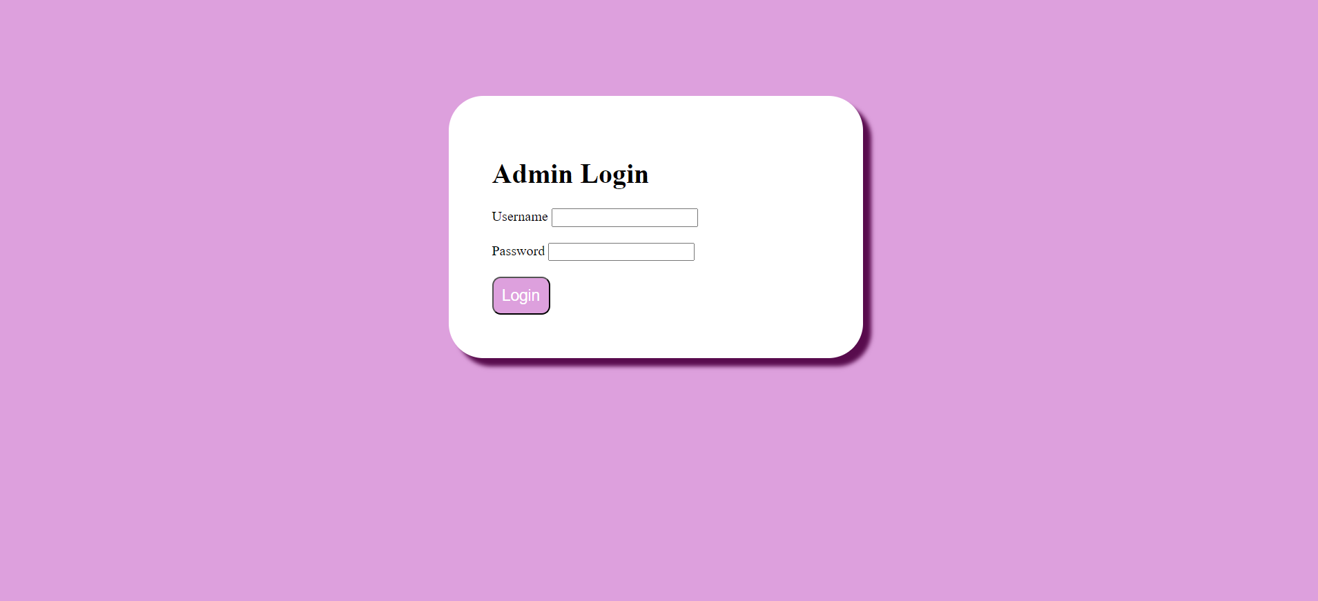

Admin

Slide 9
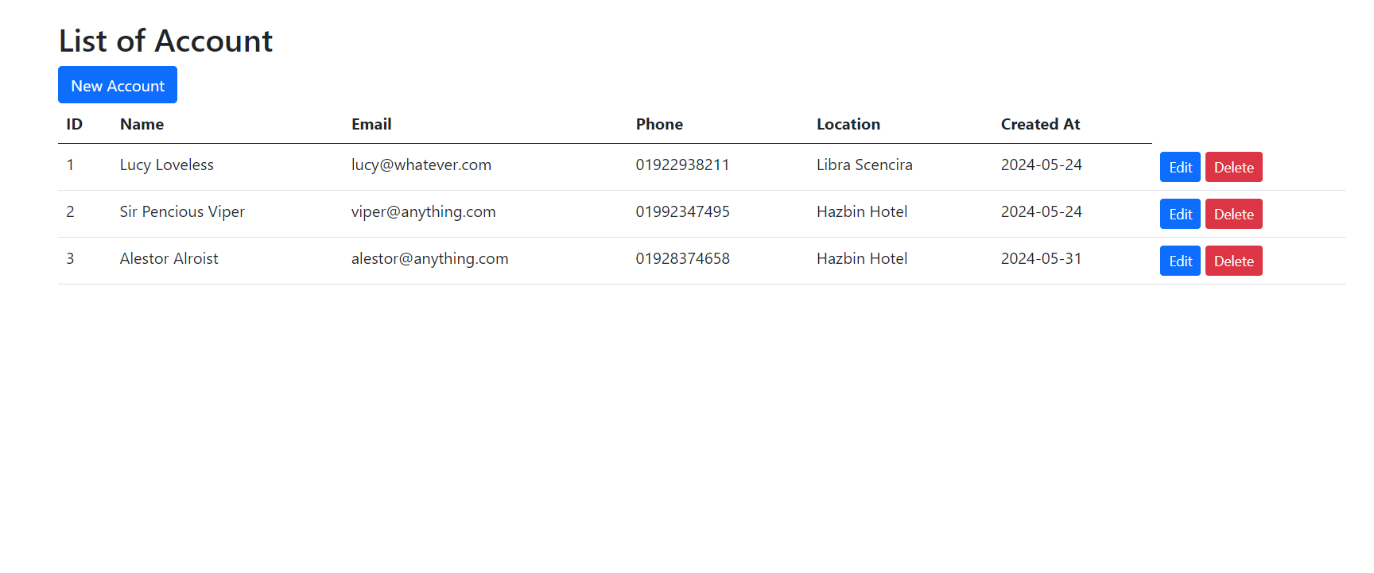
Admin

Slide 10
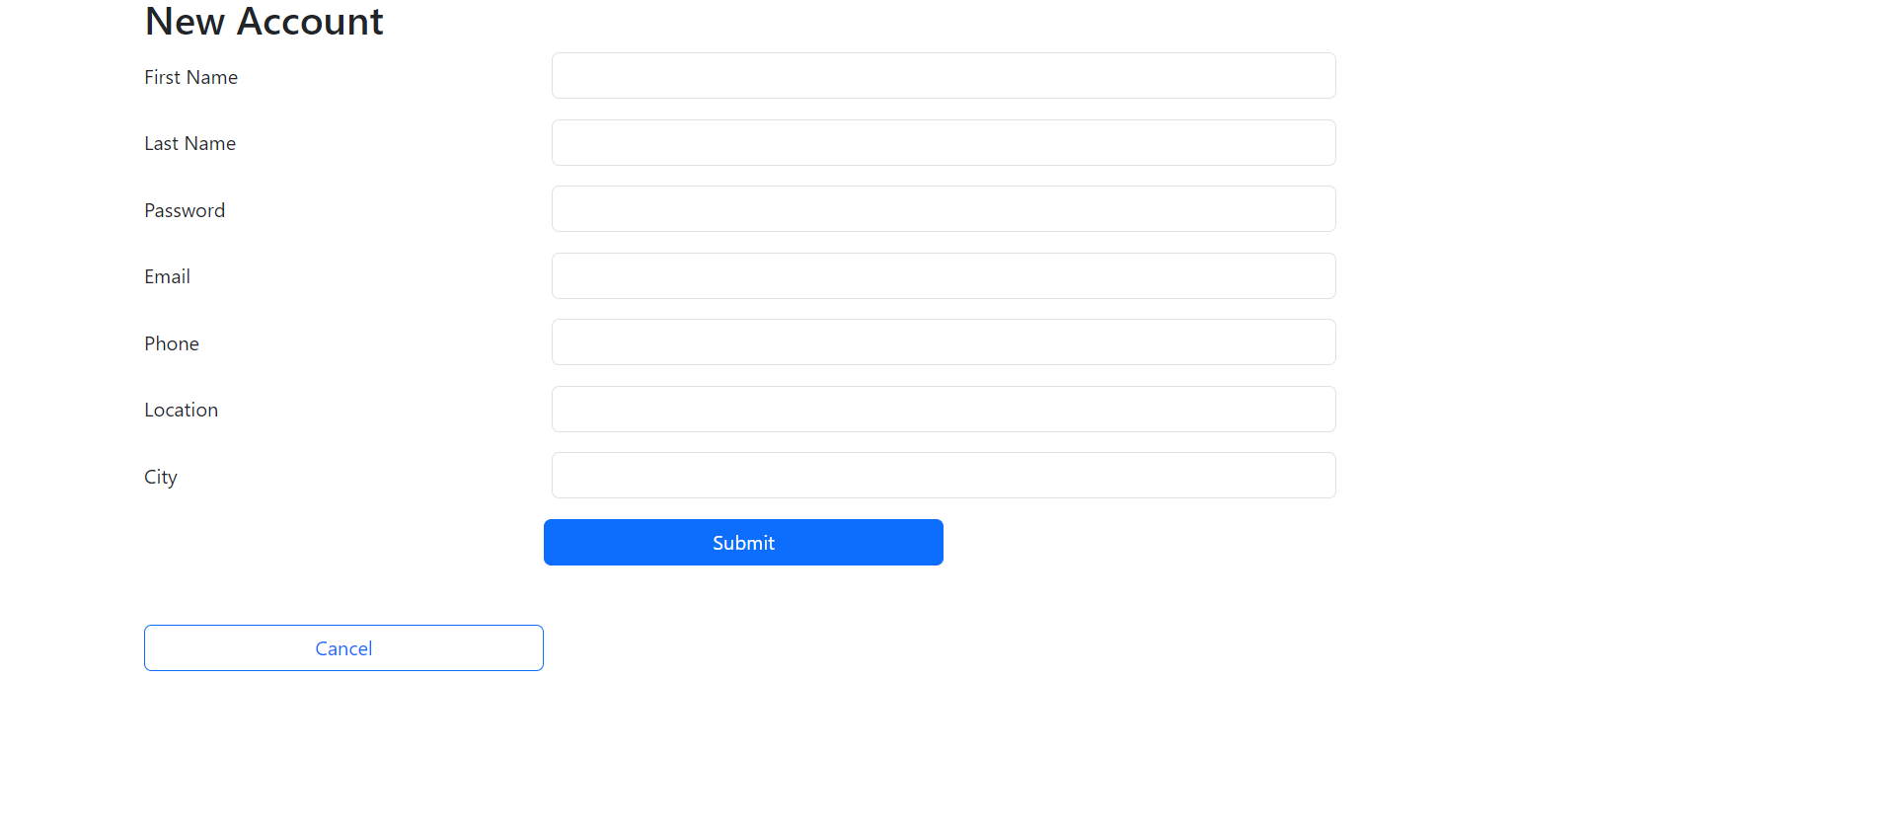
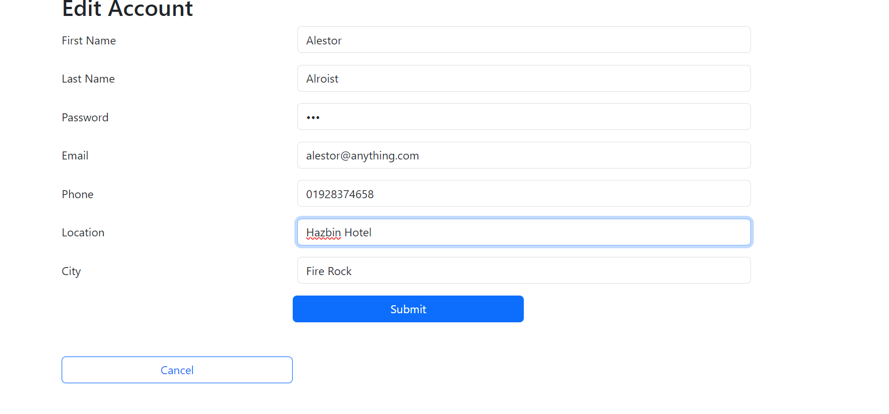
Admin

Slide 11
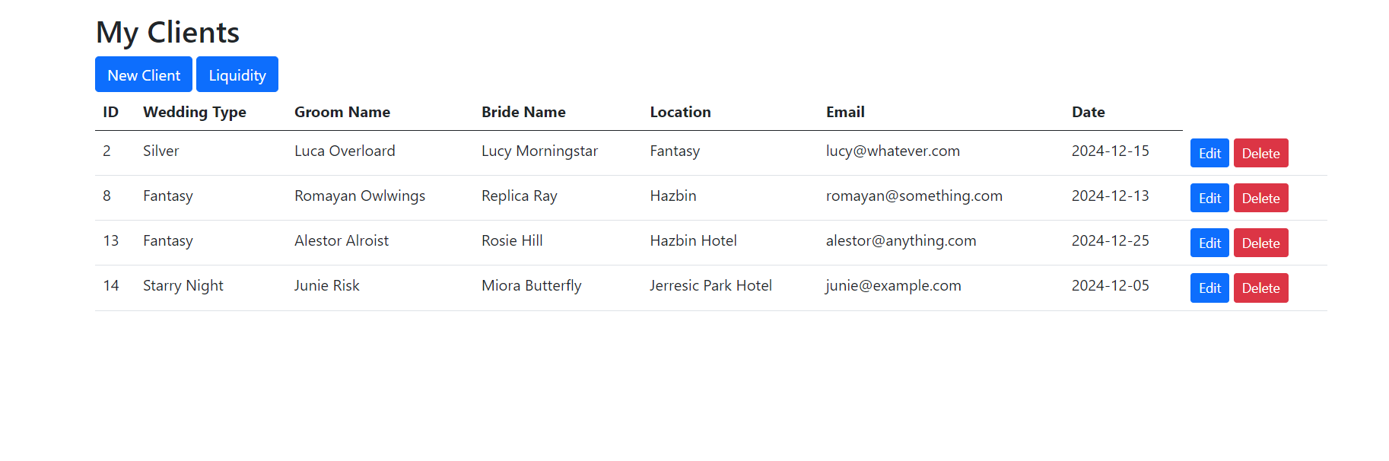
Admin

Slide 12
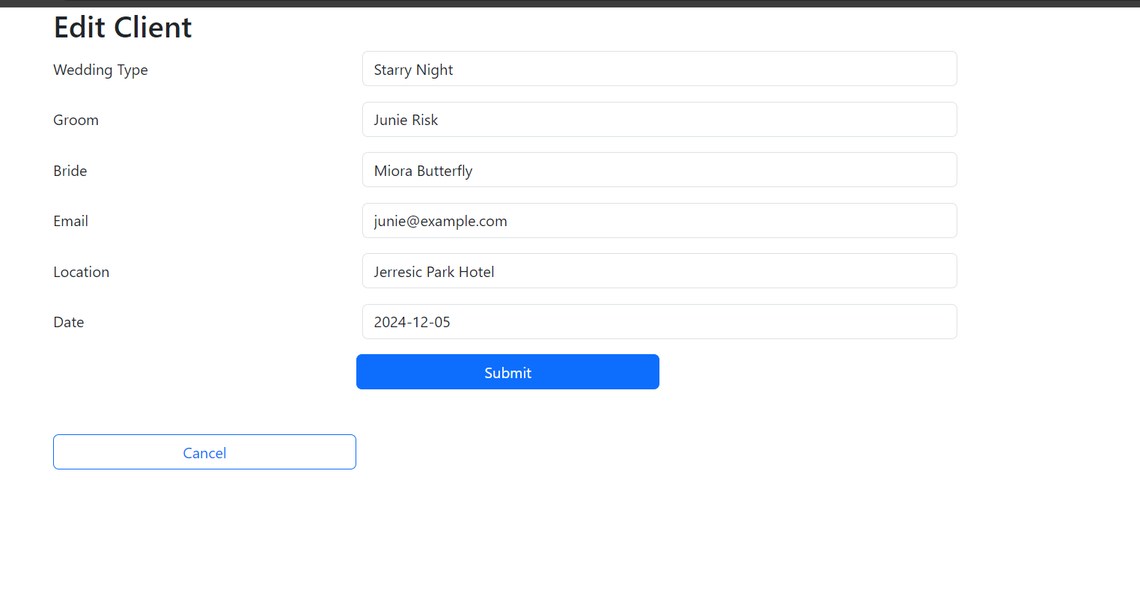
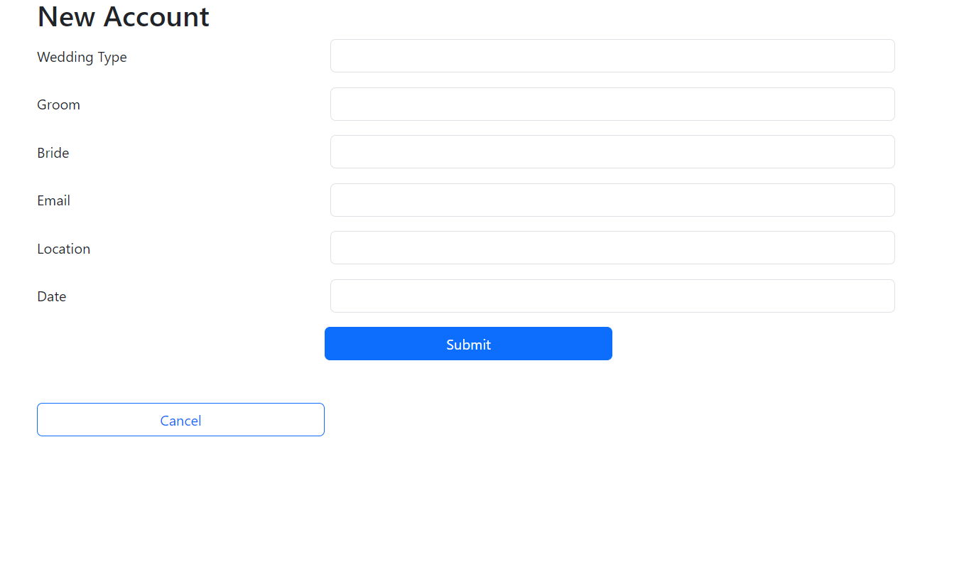
Admin

Slide 13
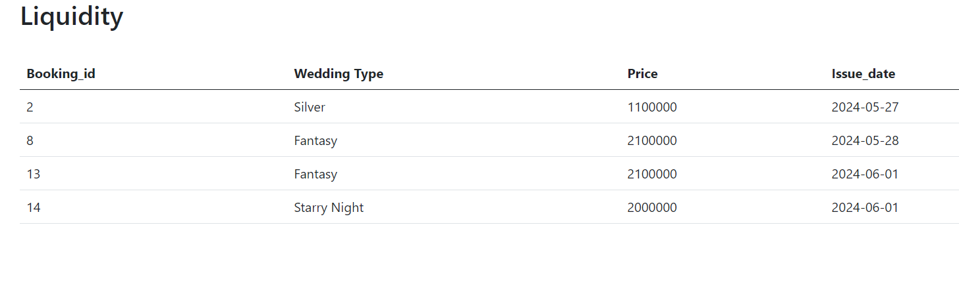
Admin

Slide 14
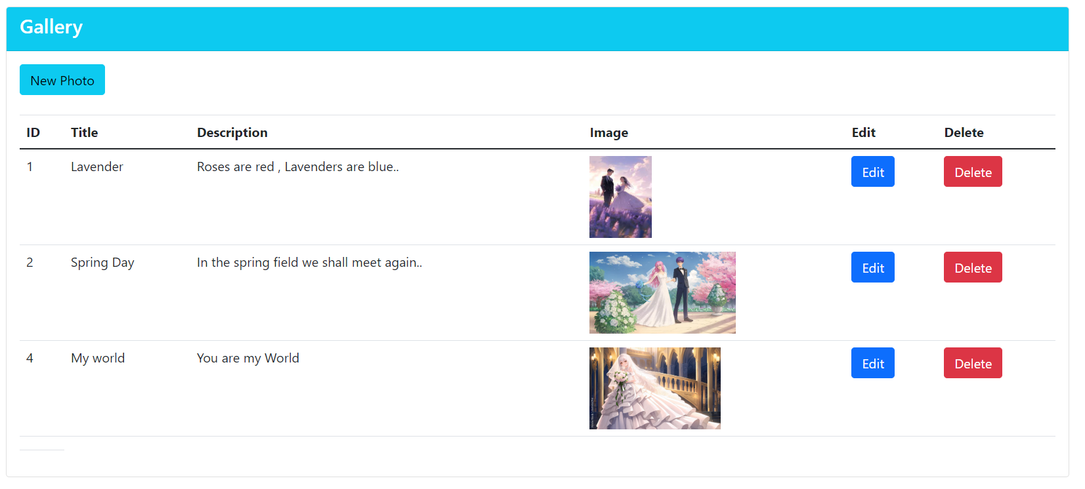
Admin

Slide 15
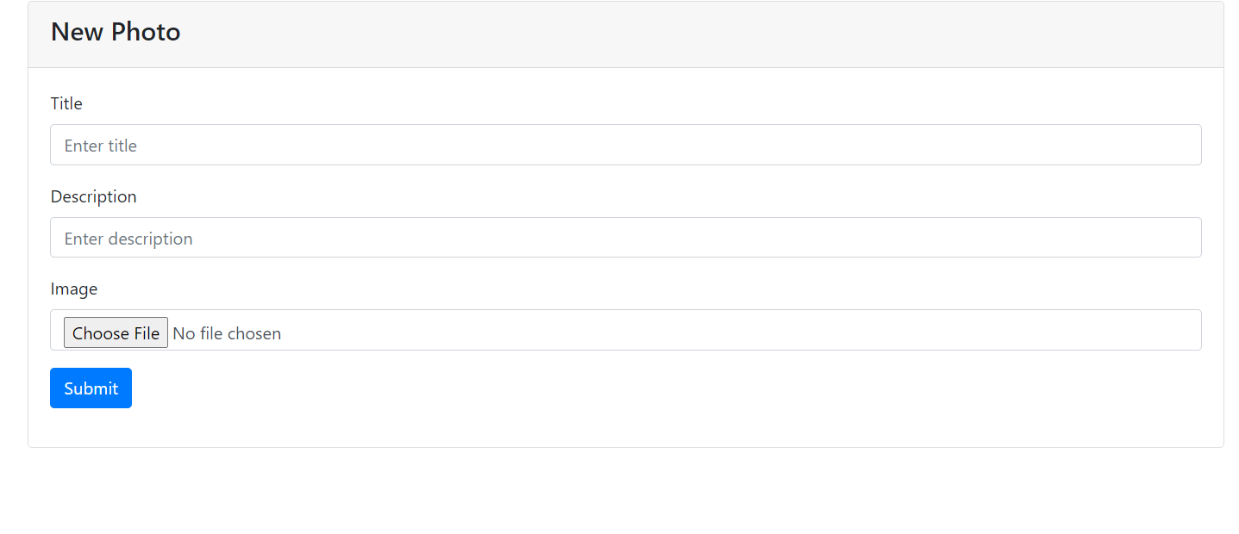
Admin

Slide 16
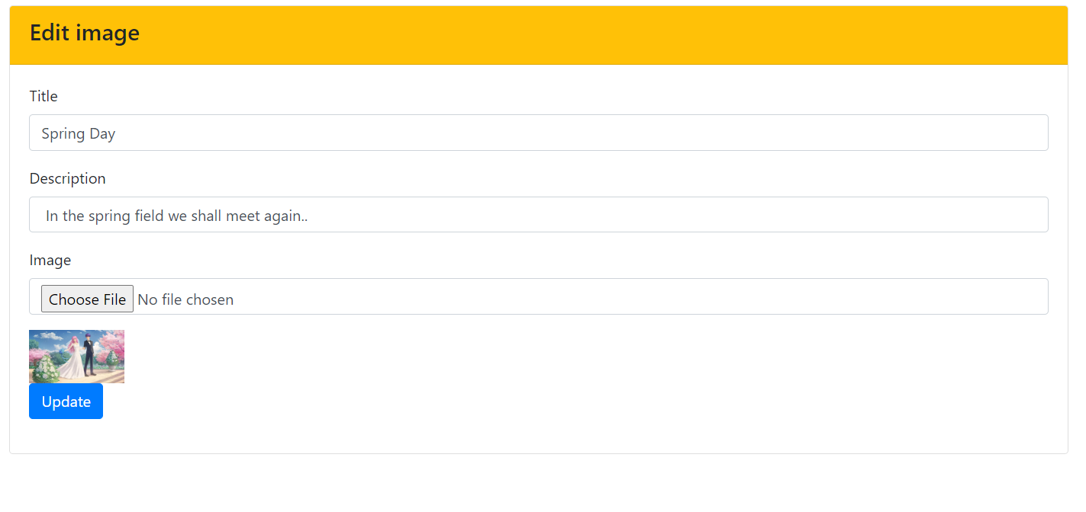
Admin

Slide 17
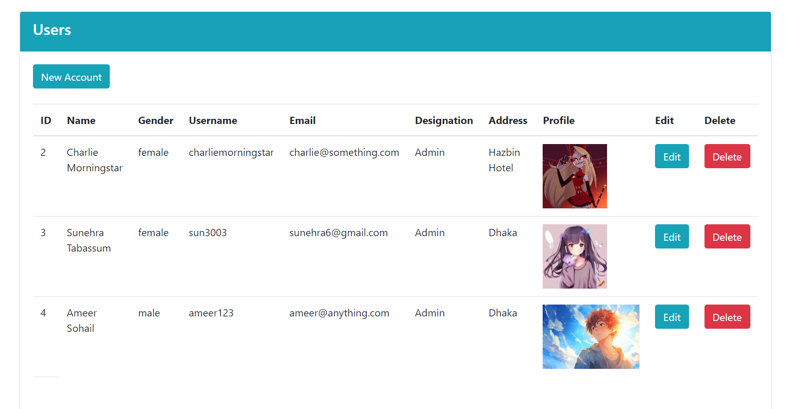
Admin

Slide 18
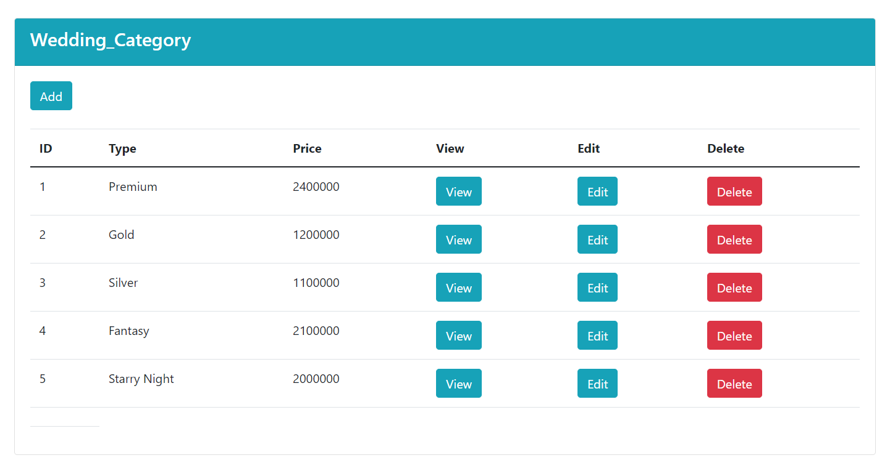
Admin

Slide 19
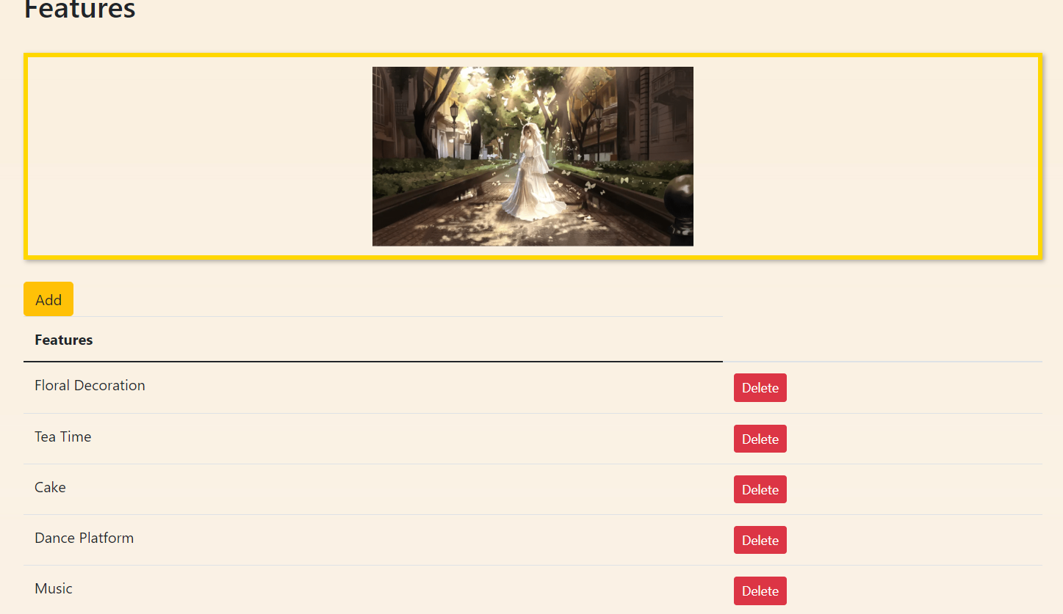
Admin

Slide 20
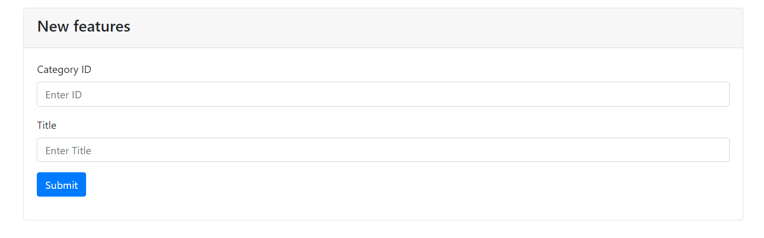
Admin

Slide 21
Guest
Pre-Login Access:
View the Contact Us Section
Explore the Gallery:
Browse Wedding Categories and Features
Sign Up
Post-Login Capabilities:
Book Weddings

Slide 22

Guest

Slide 23
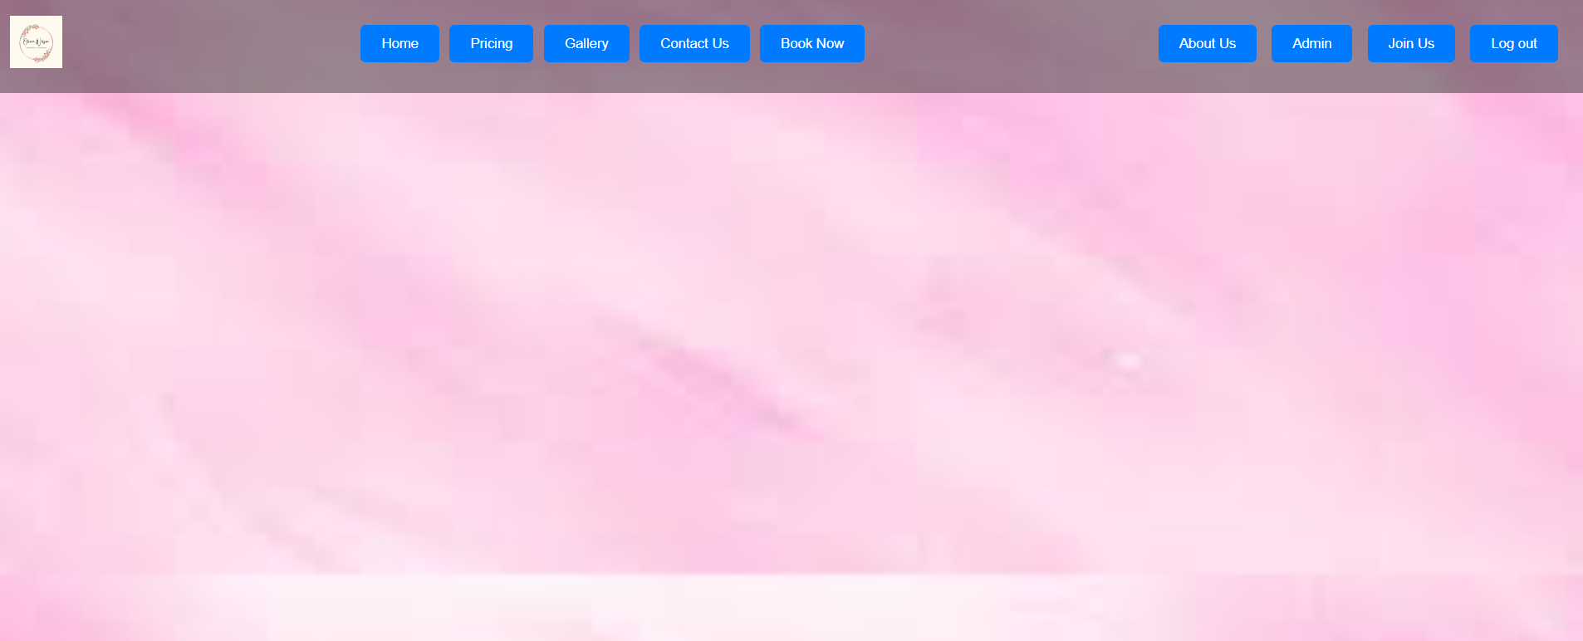
Guest

Slide 24
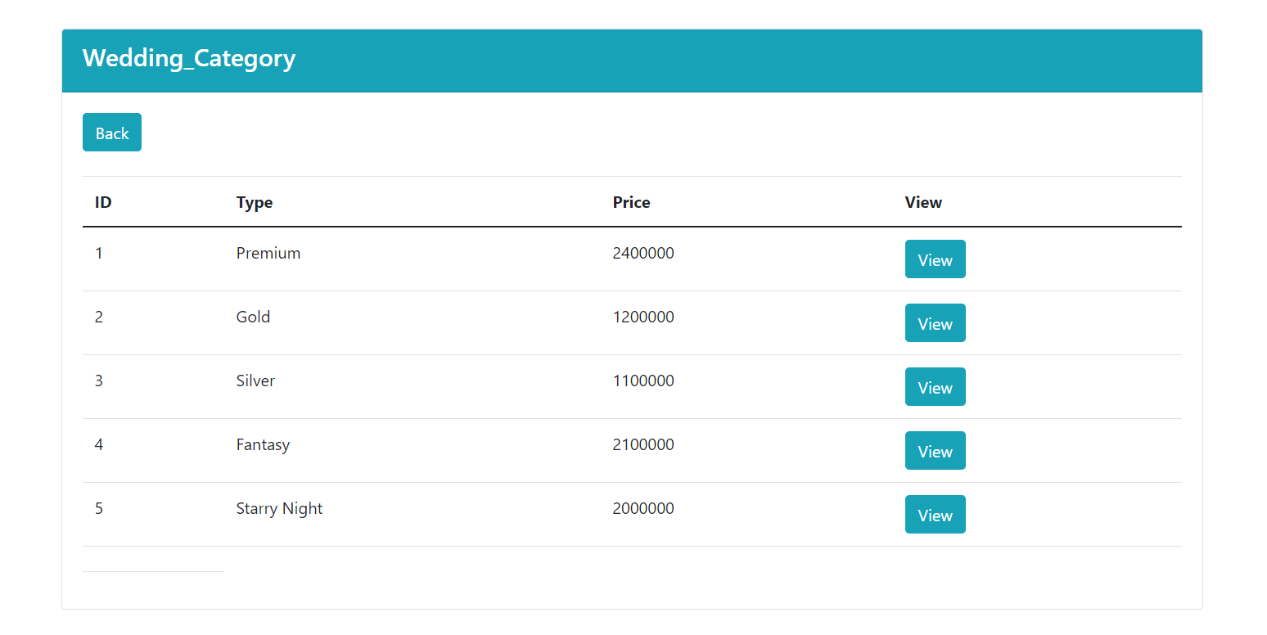
Guest

Slide 25
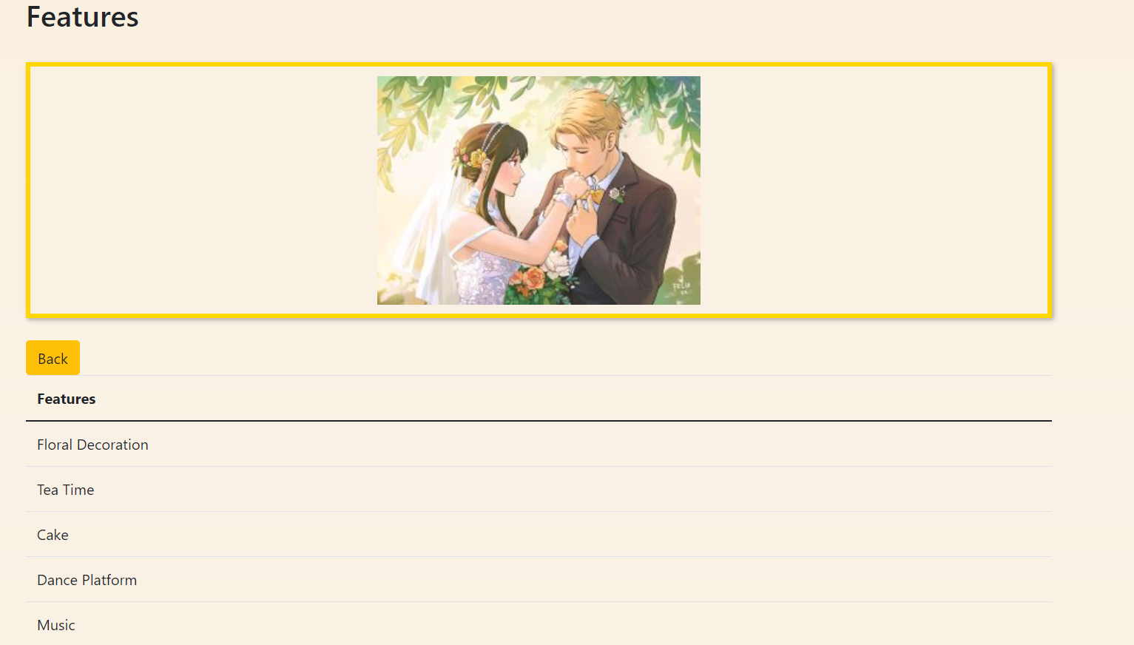
Guest

Slide 26
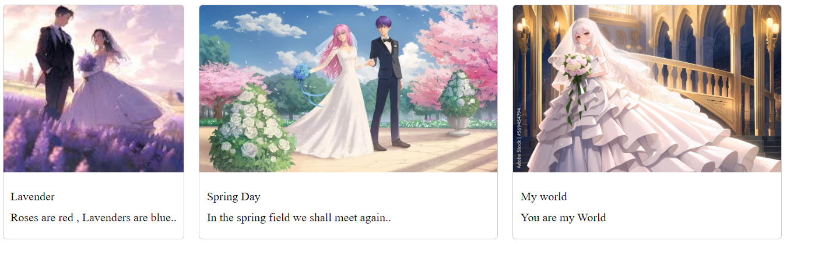
Guest

Slide 27
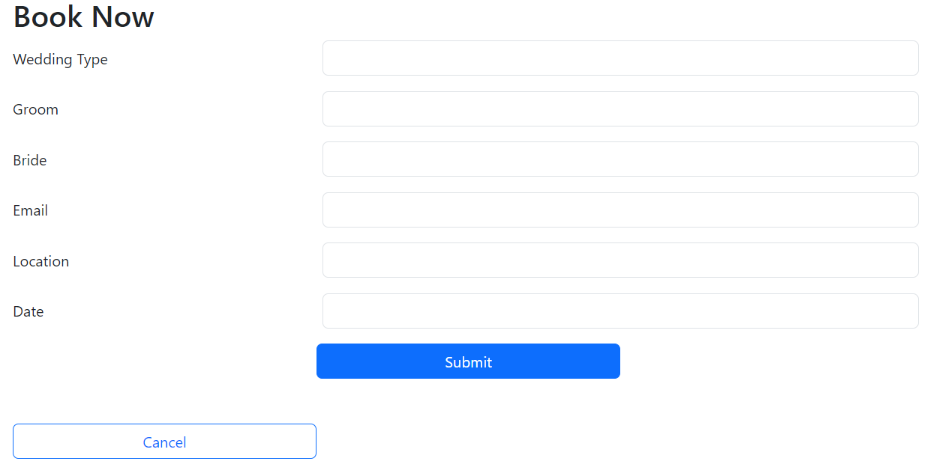
Guest

Slide 28
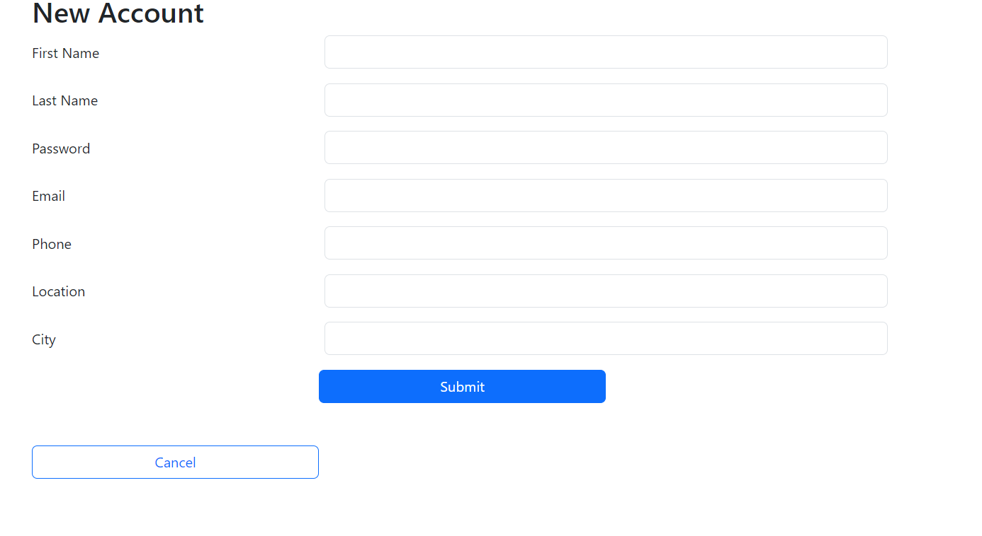
Guest

Slide 29
Conclusion
The Wedding Management System is designed to offer an efficient, user-friendly solution for wedding planning and management. With its comprehensive set of features, it enhances the experience for both guests and administrators.

Slide 30
Thank You

